Slide 1

Introduction to apache presto
BY VASANTI mAHAJAN

Slide 2
introduction to presto
Data analytics is the process of analyzing raw data to gather relevant information for better decision making. It involves working with large amount of data. As the size of data is continuously growing, we need a system which works efficiently with Petabyte size data with low latency
Facebook designed Apache Presto which is a distributed parallel query execution engine, optimized for low latency and interactive query analysis
Presto runs queries easily and scales without down time even from gigabytes to petabytes
Presto is built in Java and can easily integrate with different infrastructure components
Presto query can combine data from multiple sources, allowing for analytics across the enterprise ecosystem
Presto is powerful, and leading companies like Airbnb, DropBox, Groupon, Netflix are adopting it

Slide 3
features OF presto
Simple and extensible architecture
Pluggable connectors (Hive, MySQL, Cassandra, Kakfa, Redis, MongoDB, etc)
Pipelined execution
Vectorized columnar processing

Slide 4
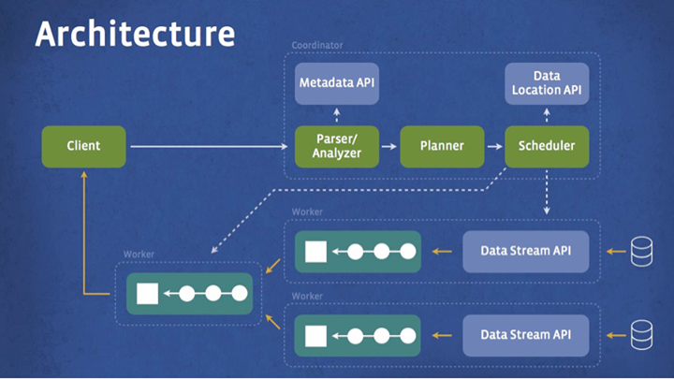
Presto architecture
The architecture is very similar to a classic MPP (Massively Parallel Processing) DBMS architecture. The following are the components and their interaction in the Presto architecture

Slide 5
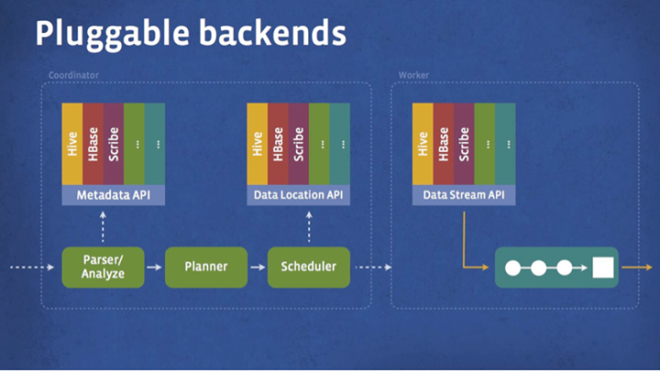
Presto architecture components
CLIENT: The client (Presto CLI) submits the SQL query to the coordinator to get the results
COORDINATOR: Coordinator is a master daemon. The coordinator initially parses the SQL queries then analyzes and plans for the query execution. Scheduler performs pipeline execution, assigns work to the closest node and monitors progress
CONNECTORS: Storage plugins are called as connectors. Hive, HBase, MySQL, Cassandra and many more act as a connector. You can also build a custom connector. The connector provides metadata and data for queries
WORKERS: The worker receives the data from connectors, performs the operations and returns the result back to the client

Slide 6
Presto workflow
Steps:
Presto client (CLI) submits SQL statements to a master daemon coordinator
The coordinator parses, analyses and plans the query execution
The scheduler connects through the execution pipeline, assigns work to nodes which are closest to the data and monitors the progress
The workers performs the operations and return the result to the client

Slide 7
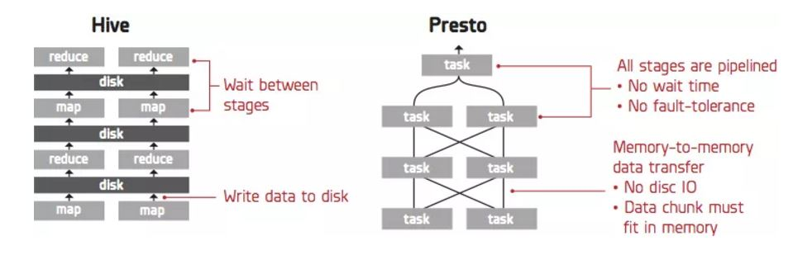
How is presto different than hive?

Slide 8
How is presto different than hive? (contd.)
HIVE | PRESTO
Optimized for throughput | Optimized for latency
Uses HiveQL | Uses ANSI SQL
Suitable for batch processing | Suitable for interactive queries
Translates SQL queries into multiple stages of MapReduce that executes one after another | Presto has a custom query engine with operators designed to support SQL semantics
Hive is fault-tolerant as it stores the intermediate results to the disk | Presto is not fault-tolerant as it stores intermediate results in memory
Reading input from disk and writing back the results causes latency overhead | Due to the network pipeline, unnecessary i/o and latency overhead is overcome

Slide 9
REFERENCES
https://en.wikipedia.org/wiki/Presto_(SQL_query_engine)
https://www.tutorialspoint.com/apache_presto/
https://www.facebook.com/notes/facebook-engineering/presto-interacting-with-petabytes-of-data-at-facebook/10151786197628920/
https://blog.treasuredata.com/blog/2015/03/20/presto-versus-hive/

Slide 10
conclusion
We would be continuing with the installation and hand-on exercise in the next lab.
THANK YOU!!

